Slide 1
Digital Logic Design and Application
Lecture #12
UESTC, Spring 2020
Verilog for sequential circuits

Slide 2
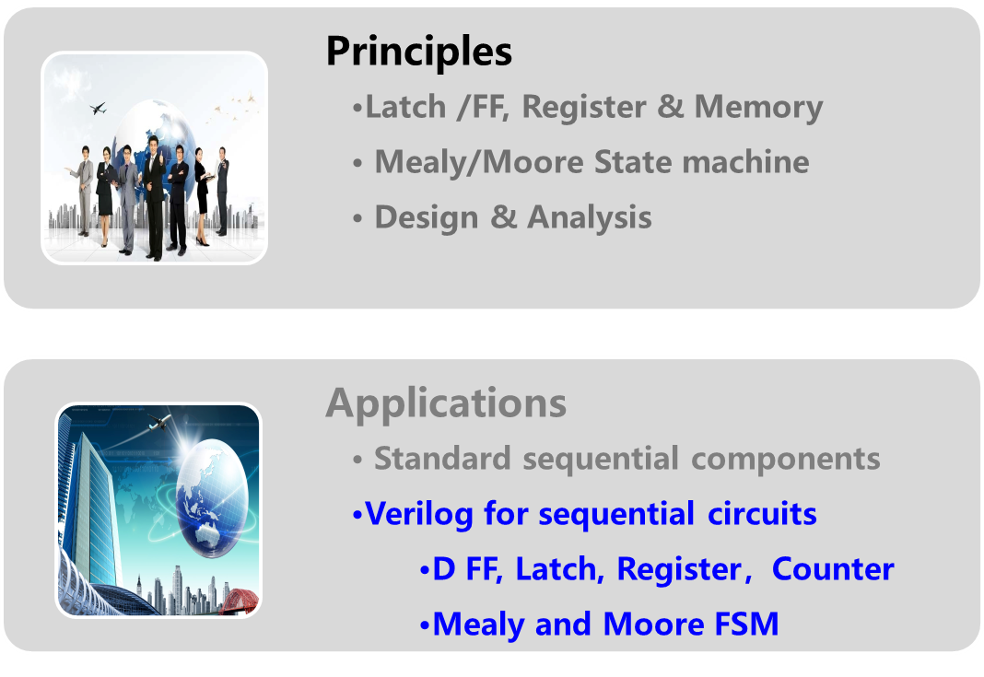
Topic2-2 sequential circuits: principles and applications

Slide 3
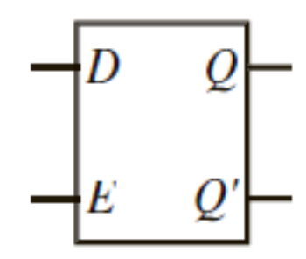
Verilog for D latches
module D_latch (
);
always @ ( )
begin
;
end
endmodule
Chap5.5
input D, E
output reg Q
D, E
D latch with enable
If (E==1)
Q = D
// blocking assignment,
“<=” will do
// if E≠1, the process will hold Q’s value, the missing for a else statement makes EDA tool synthesizing a latch in the end.
Blocking assignment (阻塞赋值，“=”) in an always process used for modeling combinational circuits. It updates the signal’s value right after the assignment is executed. Although a D latch is a sequential device, however when EN=1 it behaves more like a combinational circuits. Q follows D directly.
Because there is only one assign in the always process, so a non-blocking assignment “<=“ will do here（非阻塞赋值）.

Slide 4
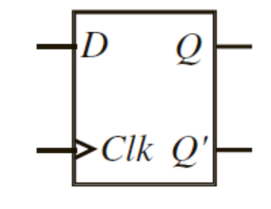
Verilog for D FFs
module D_FF (
);
always @ ( )
begin
;
end
endmodule
input CLK, D,
output reg Q
posedge CLK
// FF only changes it’s state at the active edge of the clock signal
Q <= D
// non-blocking assignment
Non-blocking assignment (“<=”) in an always process used for modeling sequential circuits. It updates all the signals at the same time after the entire process is executed. For synchronous circuits the assignments in an always process should be “<=”.

Slide 5
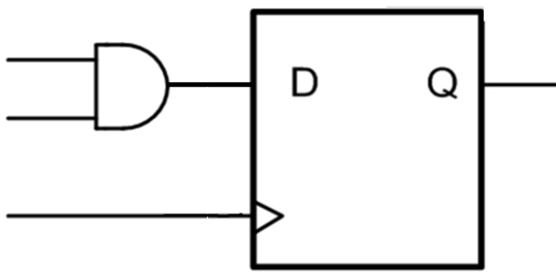
D Flip-Flop with other inputs
Chap5.10
module Flop ( );
endmodule
reset, clk, din, q
Only one trigger mode is allowed in the list, either edge or level.
input reset, clk, din;
output q;
reg q;
Flip-Flop triggers on the falling edge of clk
always @( )
begin
end
always@( )
begin
end
negedge clk
negedge clk, posedge reset
Synchronous reset
Asynchronous reset
if (reset) q <= 1'b0;
else q <= din;
if (reset) q <= 1'b0;
else q <= din;
D FF with synchronous reset
D FF with asynchronous reset
din
reset
D
Q
reset
CLK
Notes:
Always敏感列表里触发条件必须统一为边沿或者电平触发，不能同时有电平触发与边沿触发信号存在。这里为了照顾CLK的边沿出发特性将reset信号也写出边沿触发格式。然后在always模块内部检验reset是否为高电平，为高则异步复位。

Slide 6
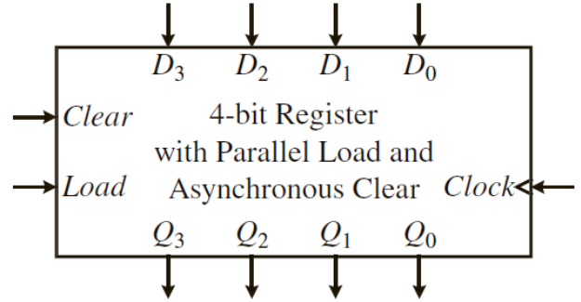
Verilog for registers
Chap5.12
module register4
(
);
always @ ( )
begin
end
endmodule
#(parameter n = 4) // constant declaration, make n changable
Clear, Load,
input CLK,
input D,
output reg Q
[n-1:0]
[n-1:0]
A 4-bit PIPO Register with asynchronous Clear
& synchronous Load
posedge CLK
， posedge Clear
// trigger condition of the same always statement must be unified, either in edge trigger or in level trigger.
if (Clear == 1)
Q <= {n {1'b0} };
// asynchronous Clear at the high level of clear signal, regardless of clk signal
else
if (Load)
Q <= D;
// synchronous load at the clk raising edge
Clear has higher precedence over load

Slide 7
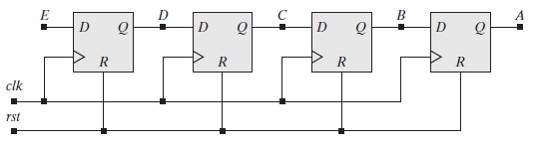
Verilog for shift registers
Chap5.15
module shiftreg (A, sin, clk, rst);
output reg A;
input sin, clk, rst;
reg B, C, D;
always @ (posedge clk or posedge rst)
begin
if (rst)
A <= 0; B <= 0; C <= 0; D <= 0;
else
A <= B; B <= C; C <= D; D <= sin;
end
endmodule
[3:0] A;
// asynchronous Clear
// asynchronous Clear at the high level of clear signal, regardless of clk signal
// Non-blocking Assignment for FFs
rst has higher precedence over shift
A<= {sin, A[3:1]}
// shift 1-bit at every clk rising edge
sin
sin
n-bits
SHIFT
REGISTER
A
rst
Clk
A 4-bit SISO Register with asynchronous Clear
Notes:
Reg变量的默认初值：FPGA=0；ASIC=随机。绝大多数是0， 这个是由eda工具来决定的。

Slide 8
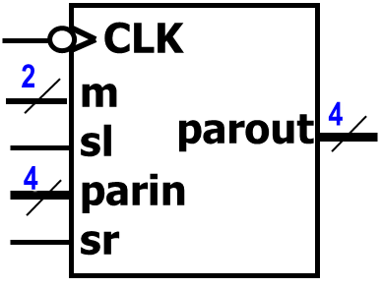
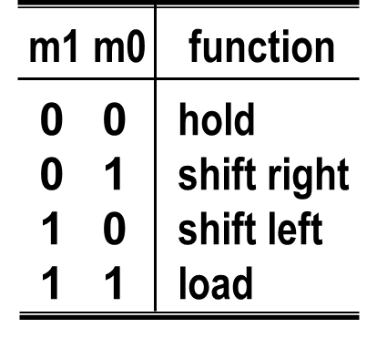
Verilog for shift registers
module uni_ShRegister4 // 4-bit universal shift-register
(input sl, sr, clk, input [3:0] ParIn,
input [1:0] m, output reg [3:0] ParOut);
always @(negedge clk)
begin
case (m)
0: ParOut <= ParOut;
1: ParOut <= {sr, ParOut [3:1]};
2: ParOut <= {ParOut [2:0], sl};
3: ParOut <= ParIn;
default: ParOut <= 4'bX;
endcase
end
endmodule
// hold
// Shifts Right
// Shifts Left
// Loads
// Undefined
Notes:
ParOut同时出现在赋值操作的两边，按理属于inout双向端口。但由于parout在always模块里被赋值，必须声明为reg类型。Verilog不允许inout端口的数据或变量为reg，只能是net型。所以要保存数据的输出，即便同时出现在赋值操作的两边，也必须声明为output端口。

Slide 9
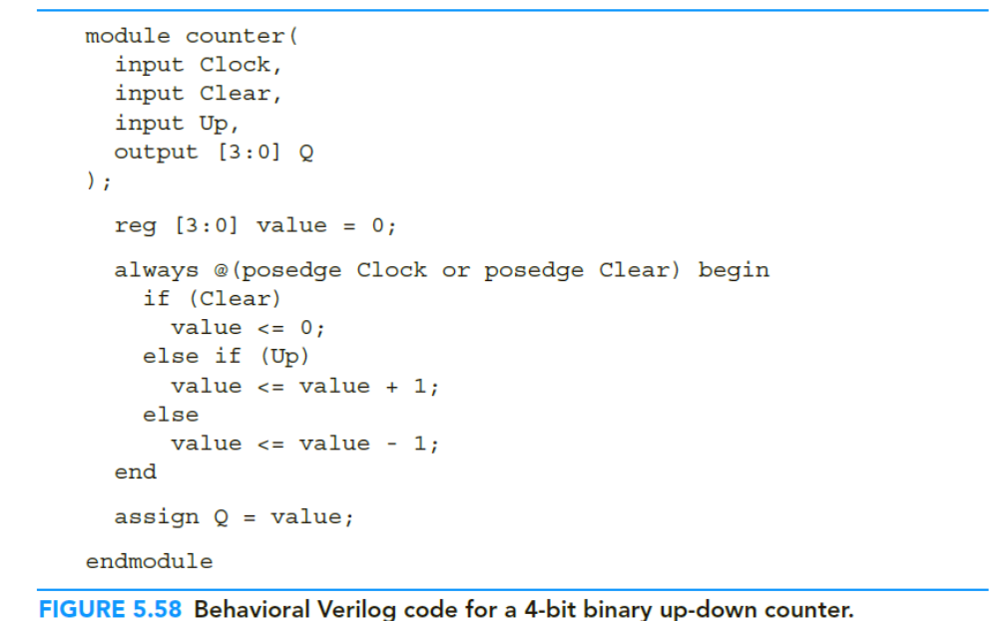
Verilog for counters
Chap5.16
// Verilog for counters
// 4-bit counter, m-16
// internal signal used to record the counting states
// asynchronous clear when clear=1
// synchronous up/down counting
// counting states upstate by continuous assignment

Slide 10
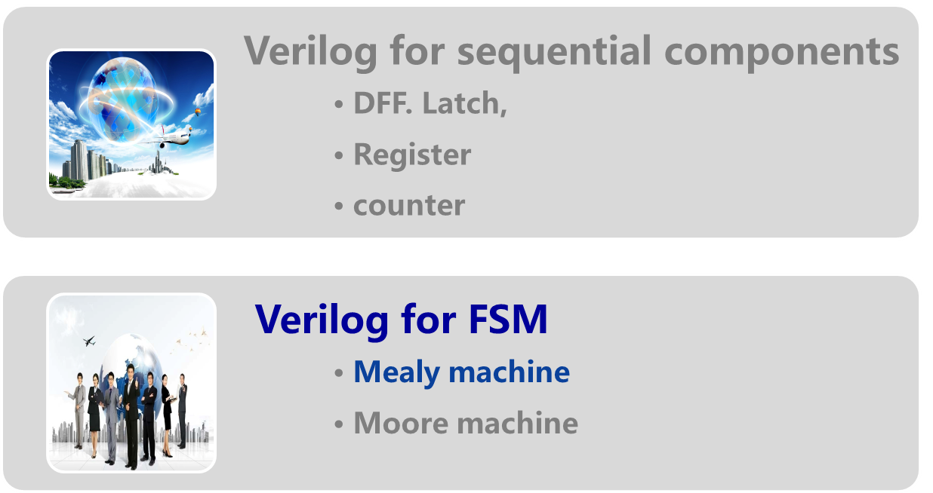
Topic2-2： Principles for sequential digital design

Slide 11
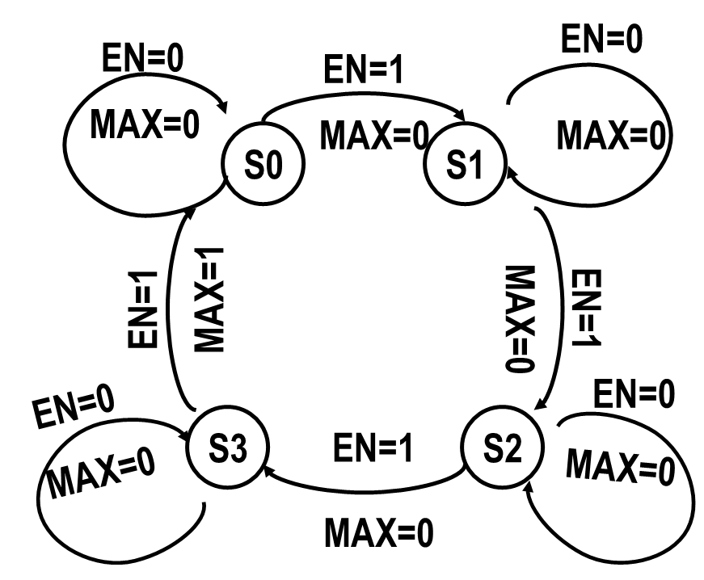
Verilog for FSM
HDL code for FSM circuits usually is done at the behavioral level. The only information that we need to know is the state table/diagram for the FSM.
State transition
  multiple branches based on current state →case
Output and the next state
  For a certain current state，the output and the next state are decided by two different input value ( EN = 0or1 ) →if else
Notes:
状态的转移属于多分支判断，应使用case语句；对输入判断只有两种情况，满足或不满足转移条件，所以用if else语句。
The states transitions( or next state logic) are implemented using a case statement. Each case branch in the case statement corresponds to a state in the state diagram. If else statements can be used to check whether the state transition conditions are satisfied.

Slide 12
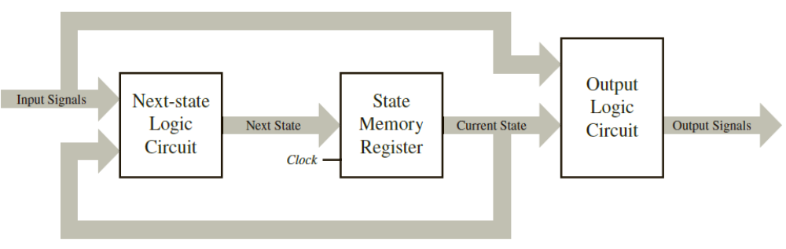
Each functional part in a FSM can be described by a Verilog block.
  Mealy FSM →3 always block
  Moore FSM →2 always block
The next state logic and output logic are combinational while the state update logic is sequential.
  The states update : <= (non-blocking assignment)
  The next state logic and output: assign = (continuous assignment)
Notes:
FSM 用几个always模块实现没有硬性规定，从结构清晰、可读出发，Mealy用3个，Moore用2个。实际Mealy也可以用2个甚至一个always模块实现。Moore也可以用一个always模块实现。

Slide 13
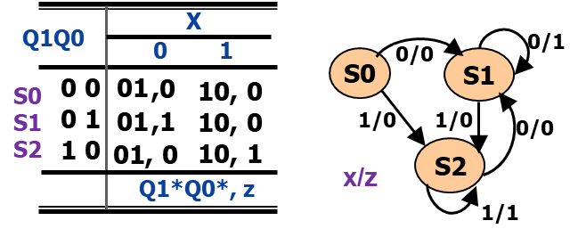
Chap6.4，6.5
state <= next_state; // “<=” for sequential
case （state）
S0 : if (x==0) next_state=S1; z=0; else next_state=S2; z=0;
S1: if (x==0) next_state=S1; z=1; else next_state=S2; z=0;
S2: if (x==0) next_state=S1; z=0; else next_state=S2; z=1;
default: next_state=S0; z=0;
// “=” for combinational
endcase;
module behavioral_Mealy _FSM
#( parameter S0=0,S1=1,S2=2) )
(output reg z, input x, clk);
reg [1:0] state, next_state;
always @ ( )
begin
end
always @ ( )
begin
end
always @ ( )
begin
end
endmodule
// state name and it’s encodings
posedge clk
// synchronous state update based on clk edge
Update State (Sequential circuit)
case （state）
S0 : z=0;
S1: if (x==0) z=1; else z=0;
S2: if (x==0) z=0; else z=1;
default z=0;
// “=” for combinational
endcase;
state or x
// state transition based on current state and the input
Next state (Combinational )circuit
state or x
// state transition based on current state and the input
Output (Combinational )circuit
Notes:
1.采用parameter定义状态变量，并对其进行编码；或者也可以用Synthesizer automatically takes care of the state encoding, the states need only to be labeled with their logical names.
2.parameter 和 localparam
parameter可用作在顶层模块中例化底层模块时传递参数的接口，localparam的作用域仅仅限于当前module，不能作为参数传递的接口。
3. define，是宏定义，全局有效。则在整个工程都是有效
parameter，参数，可以由调用者修改参数值。
localparam，本地参数，调用者不可修改。

Slide 14
state <= next_state; // “<=” for sequential
Chap6.4，6.5
case （state）
S0 : if (x==0) next_state=S1; z=0; else next_state=S2; z=0;
S1: if (x==0) next_state=S1; z=1; else next_state=S2; z=0;
S2: if (x==0) next_state=S1; z=0; else next_state=S2; z=1;
default: next_state=S0; z=0;
// “=” for combinational
endcase;
module behavioral_Mealy_FSM
#( parameter S0=0,S1=1,S2=2) )
(output reg z, input x, clk);
reg [1:0] state, next_state;
always @ ( )
begin
end
always @ ( )
begin
end
endmodule
// state name and it’s encodings
posedge clk
// synchronous state update based on clk edge
Update State (Sequential circuit)
state or x
// state transition and output logic based on current state and the input
Next state &Output (Combinational )circuit
Notes:
输出和状态转移都取决于现态state、和输入x，所以可以写在一个模块里。这样用2个always模块也可以表示mealy fsm。

Slide 15
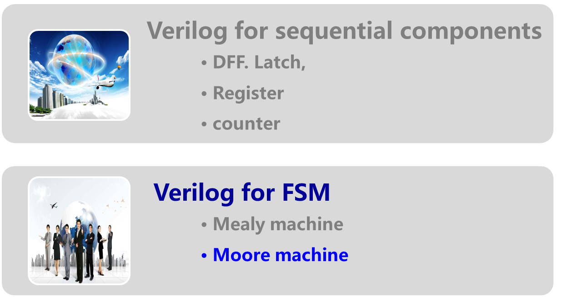
Topic2-2： Principles for sequential digital design

Slide 16
module fsm_moore_seq
（input clk,
output Y );
always @ ( posedge clk )
begin
end
always @ ( state )
begin
end
endmodule
state <= next_state;
#( parameter S0=0,S1=1,S2=2, S3=3, S4=4, S5=5 )
case （state）
S0 : begin
next_state=S1; Y=1;
end
S1: begin
next_state=S2; Y=1；
end
S2: begin
next_state=S3; Y=0;
end
S3: begin
next_state=S4; Y=1;
end
S4: begin
next_state=S5; Y=0;
end
S5: begin
next_state=S0; Y=0;
end
default: begin
next_state=S0; Y=1;
end
end case
reg [2:0] state, next_state;
// synchronous state update based on clk edge
Update State (Sequential circuit)
// state transition and output logic based on current state
Next State& Output (Combinational circuit)
//assign the next state/output for the unused states
Notes:
序列发生器，输出序列1101001，没有输入，仅有clk。输出和状态转移都取决于现态，用2个模块就可以完成。
当然为了可读性，把输出单独用一个always模块来表示也可以。

Slide 17


Digital Logic Design and Application
Topic 4 - Timing analysis
Yan Bo
School of Communication & Information Engineering, UESTC
Email: yanboyu@uestc.edu.cn
THE END OF Topic2-2

Slide 18
Required reading
  数字集成电路与系统设计
  李广军、郭志勇等，电子工业出版社
      Chapter 9, 仿真验证与时序分析
  wikipedia, baidu…….
  bbs.eetop.cn, www.ednchina.com

Slide 19
Homework2-2
P211 5.5、5.7、5.10、5.11
P271 6.1（ c ）、 6.3（ f）、6.7

